Slide 1
DB CACHING USING FIREBASE
ADITI YAWALE
OMNEVU.COM ASSIGNMENT

Slide 2
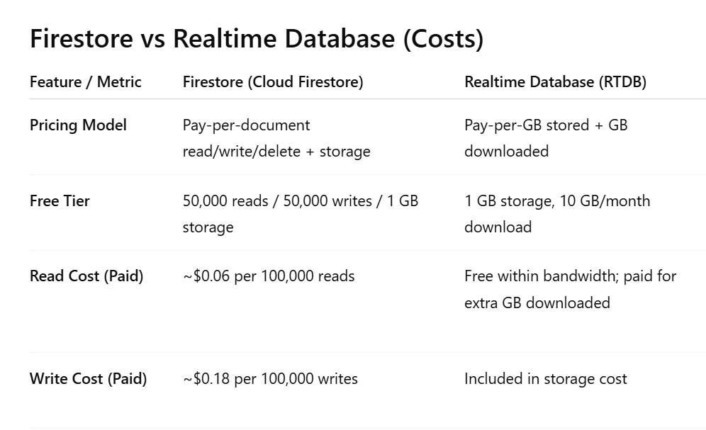
PROBLEM STATEMENT
To use Realtime Database as a cache layer and Firestore the main database layer.
motivation
Firestore is scalable but charges per read/write.
Repeated reads of the same data leads to high latency & cost.
We can reduce Firestore reads and improve response time by Implementing a caching layer using RTDB
Due to Real-time Updates, RTDB syncs instantly to clients.

Slide 3
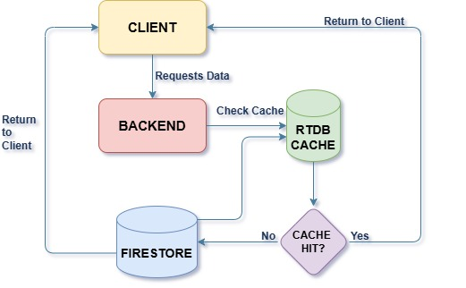
system architecture

Slide 4
Reference document
https://developers.google.com/looker-studio/connector/firebase-cache

Slide 5
thankyou

